Slide 1
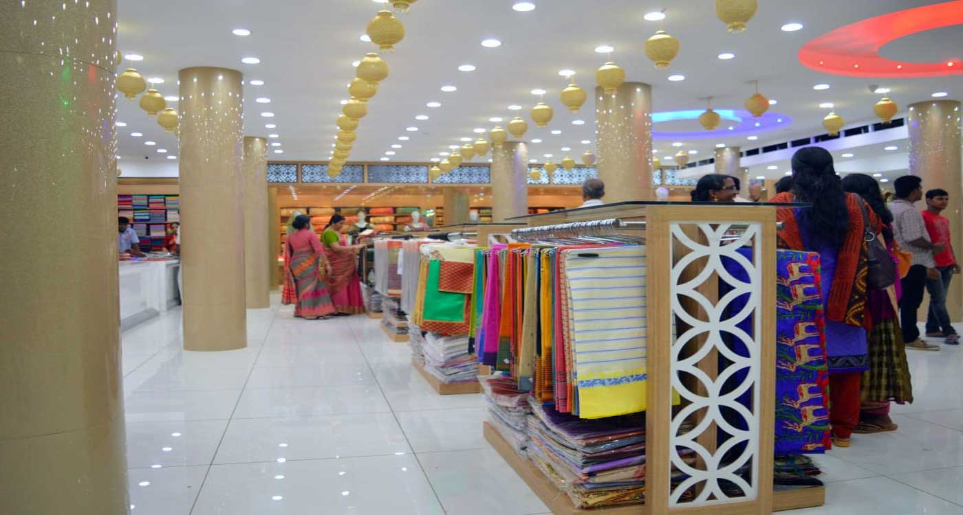
HUBLI SILKS

Slide 2
Feature1: Diverting the buyer about to buy

Slide 3
Feature2: knowing the customer, wife ,children and their age

Slide 4
Feature3:Customer age and background

Slide 5
Feature4: 3d printing of the clothes.

Slide 6
Feature5: timing of customer buying during festival time or January first

Slide 7
Feature6: went without buying

Slide 8
Feature7: Imaginary appearance

Slide 9
Feature8: diverting the would be buyers from amazon ,flipkart, and meesho

